Slide 1
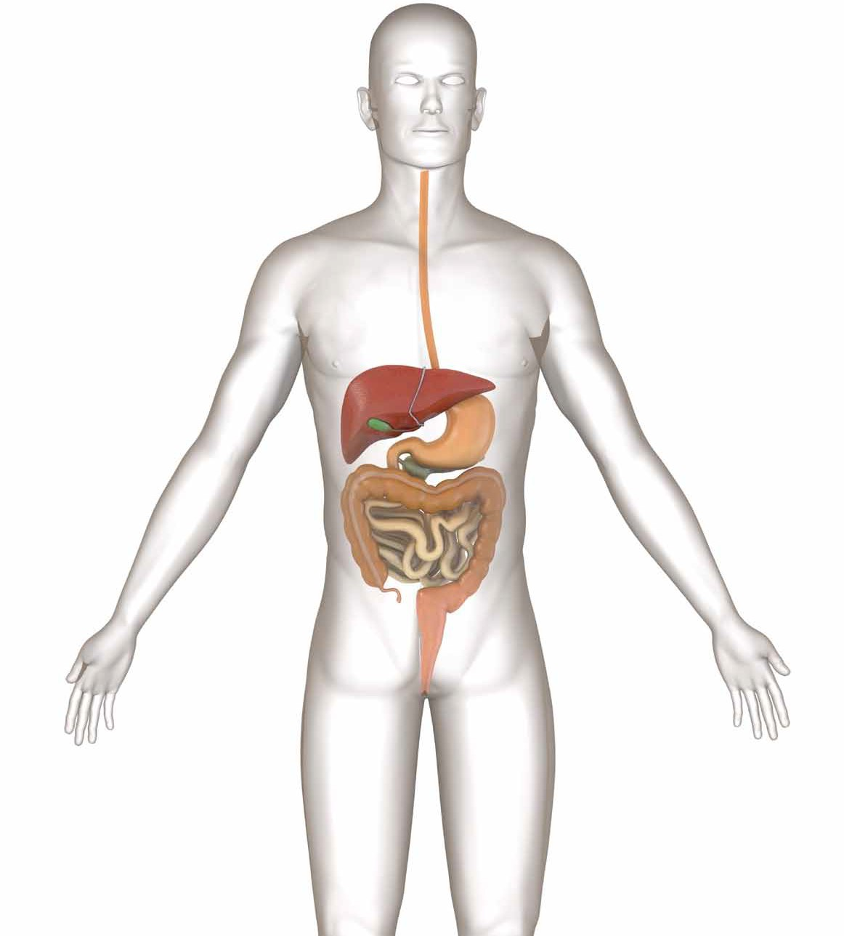

stomach

Slide 2


Slide 3
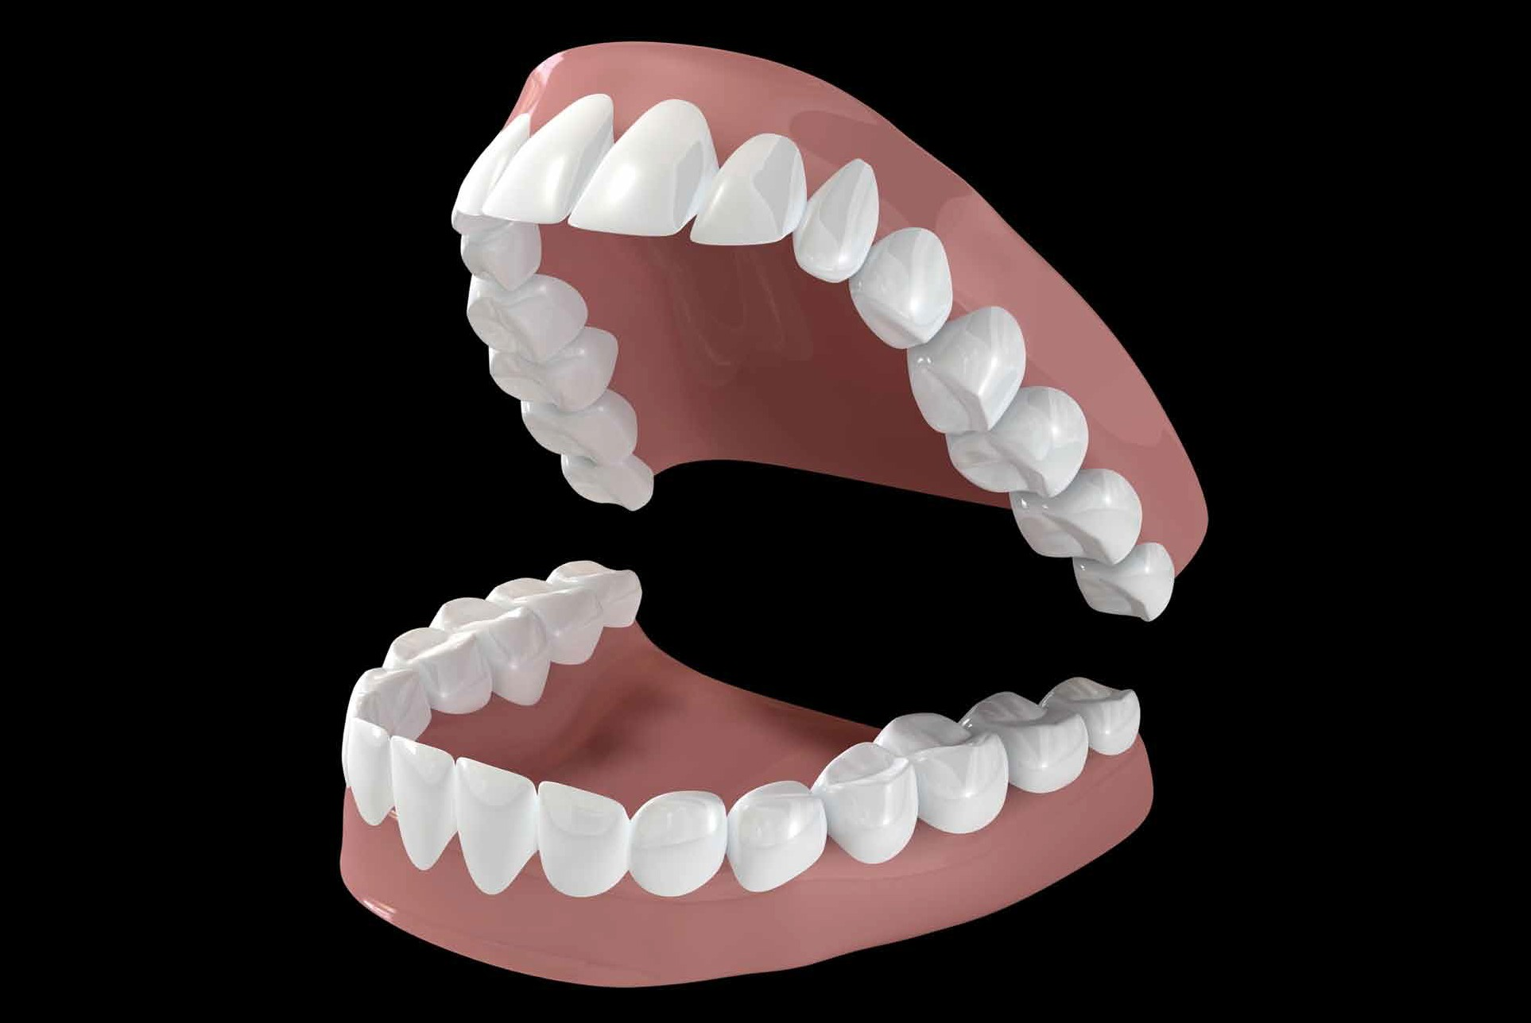

Slide 4
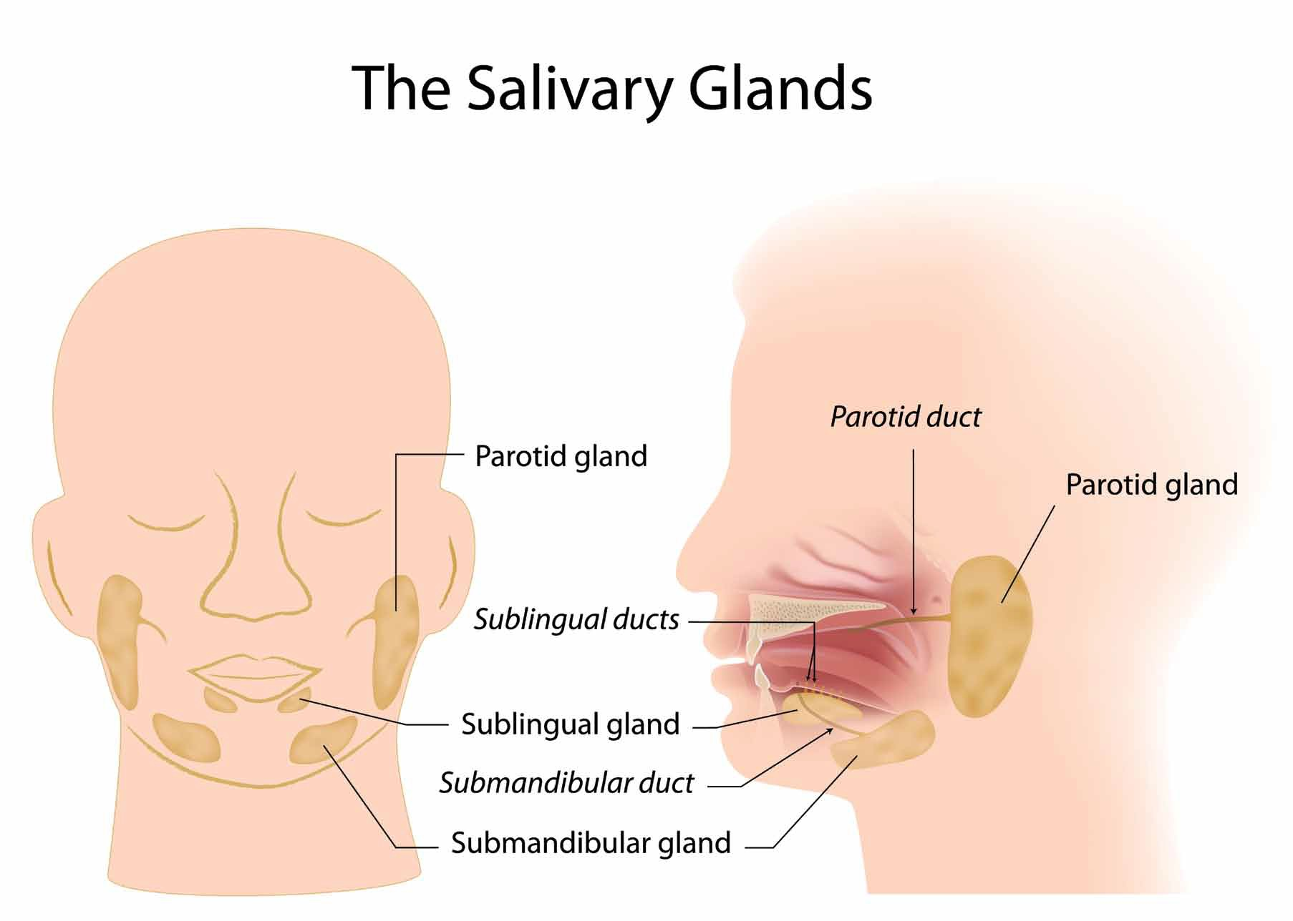

Slide 5
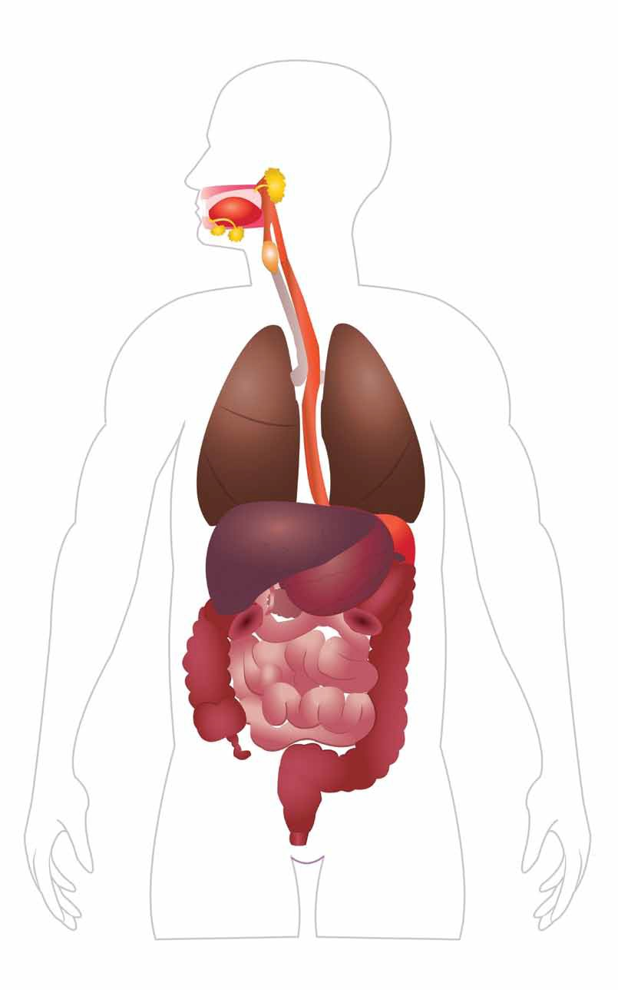
salivary glands
tongue salivary glands
esophagus
stomach

Slide 6
stomach

Slide 7
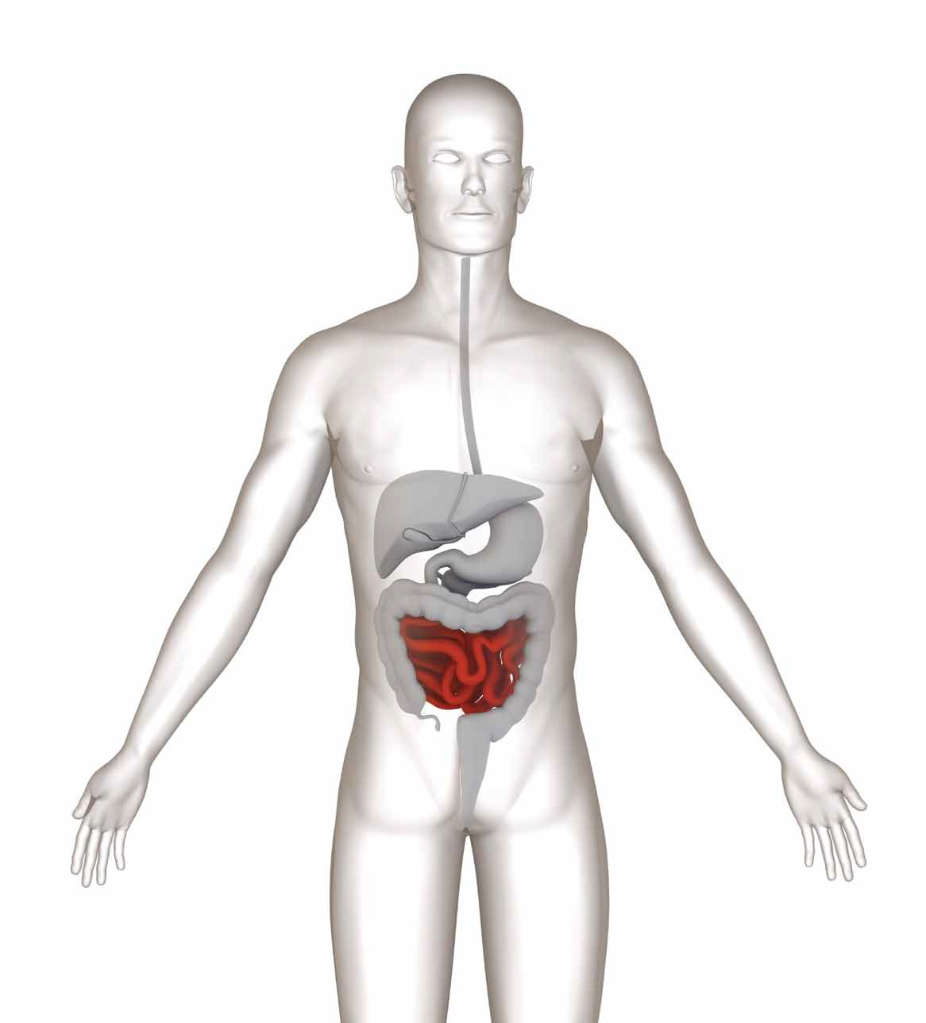
small intestine

Slide 8
cross-section of the small intestine
villi

Slide 9
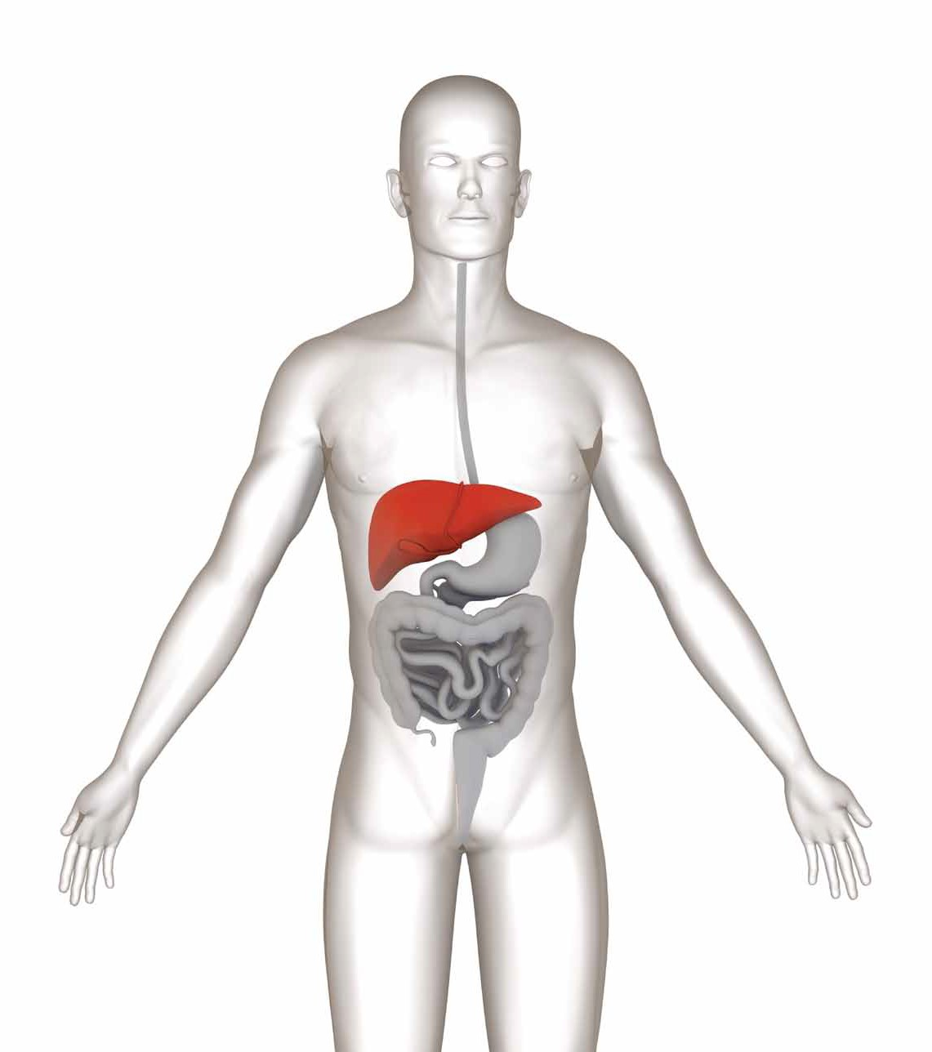
liver

Slide 10
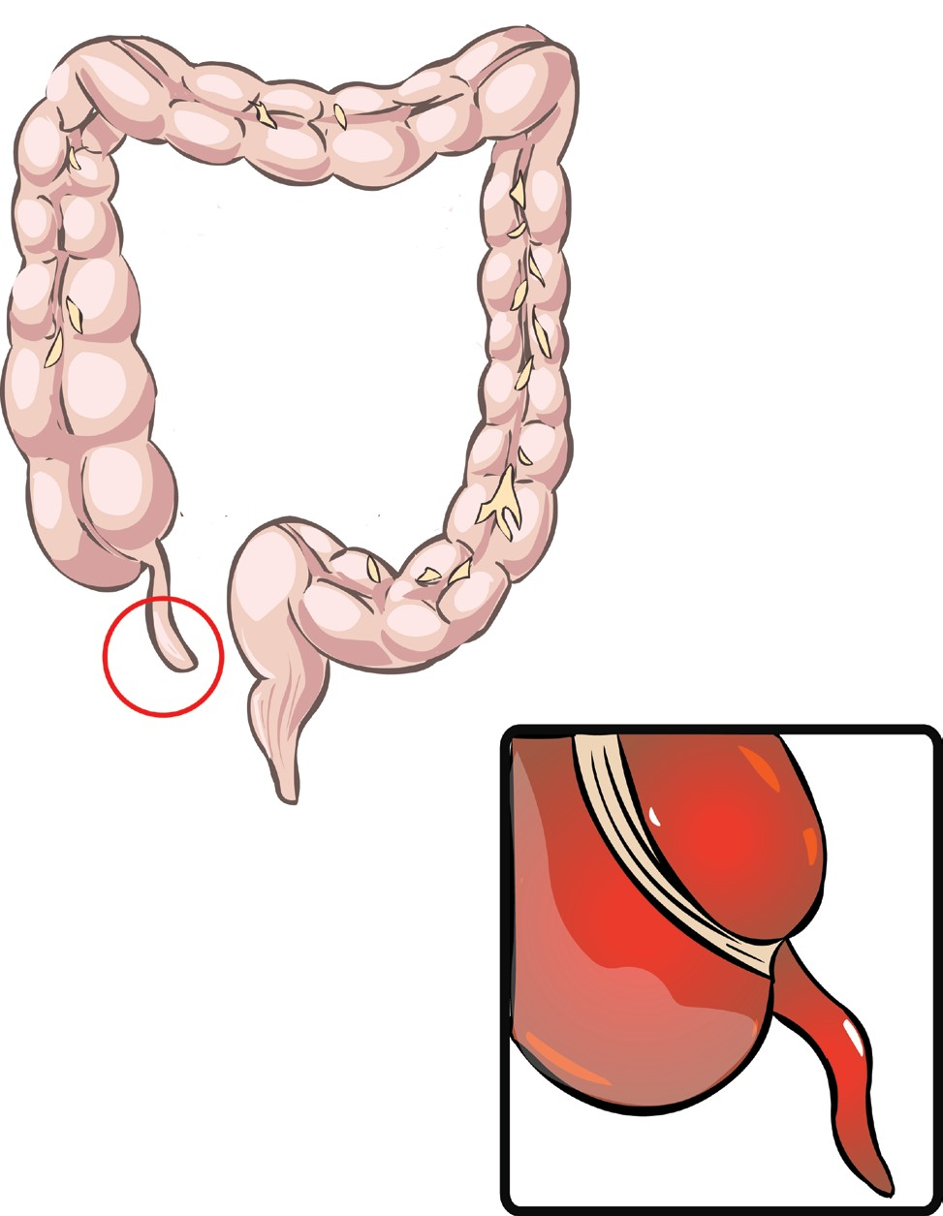
appendix
5A-10

Slide 11
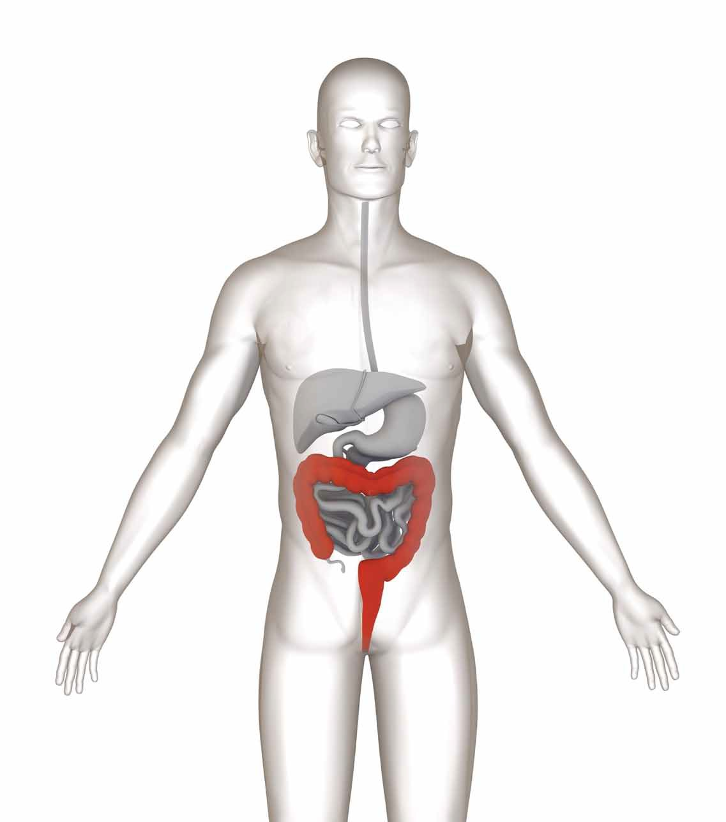
large intestine

Slide 12
