Slide 1

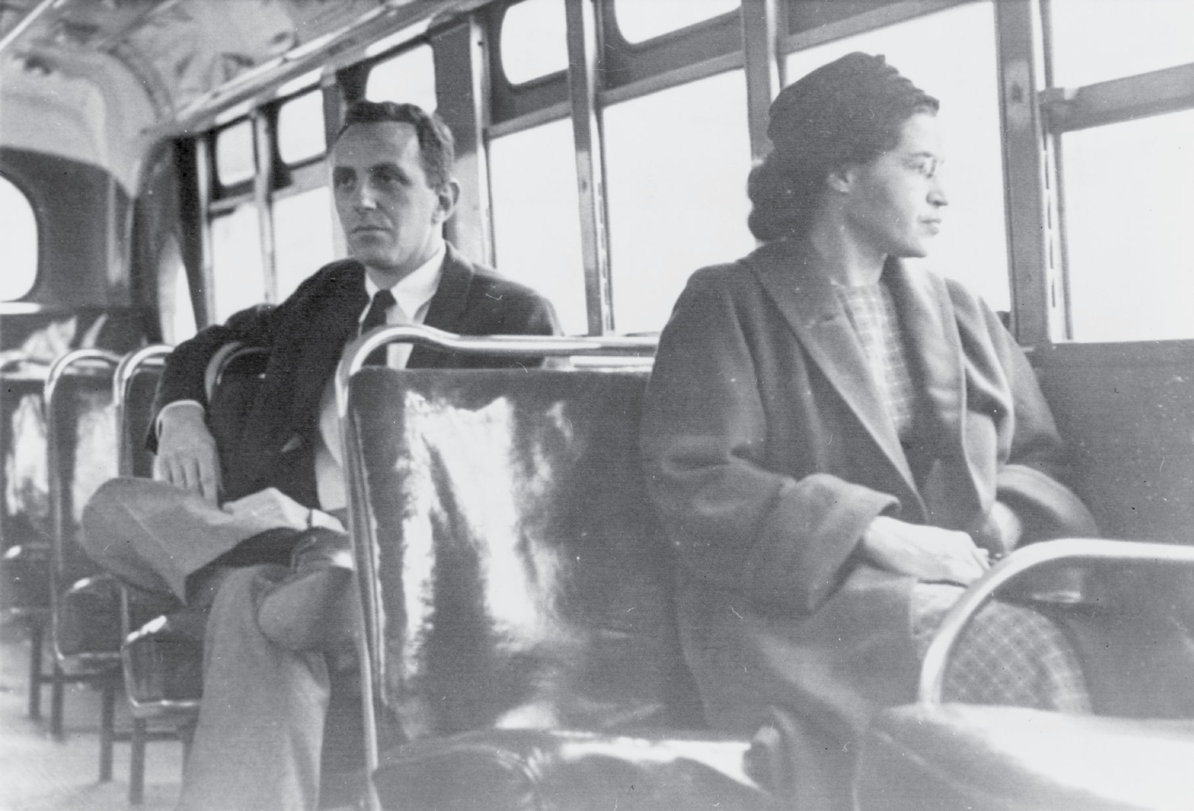

Slide 2
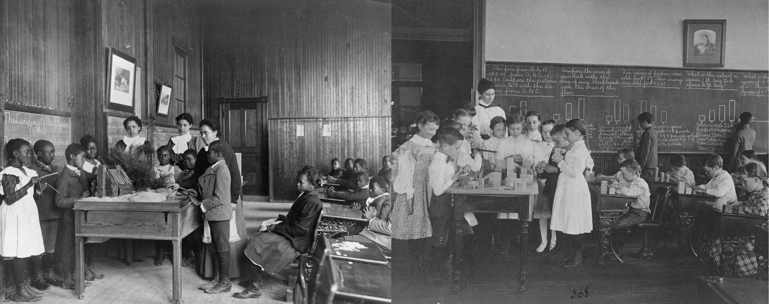

Slide 3


Slide 4
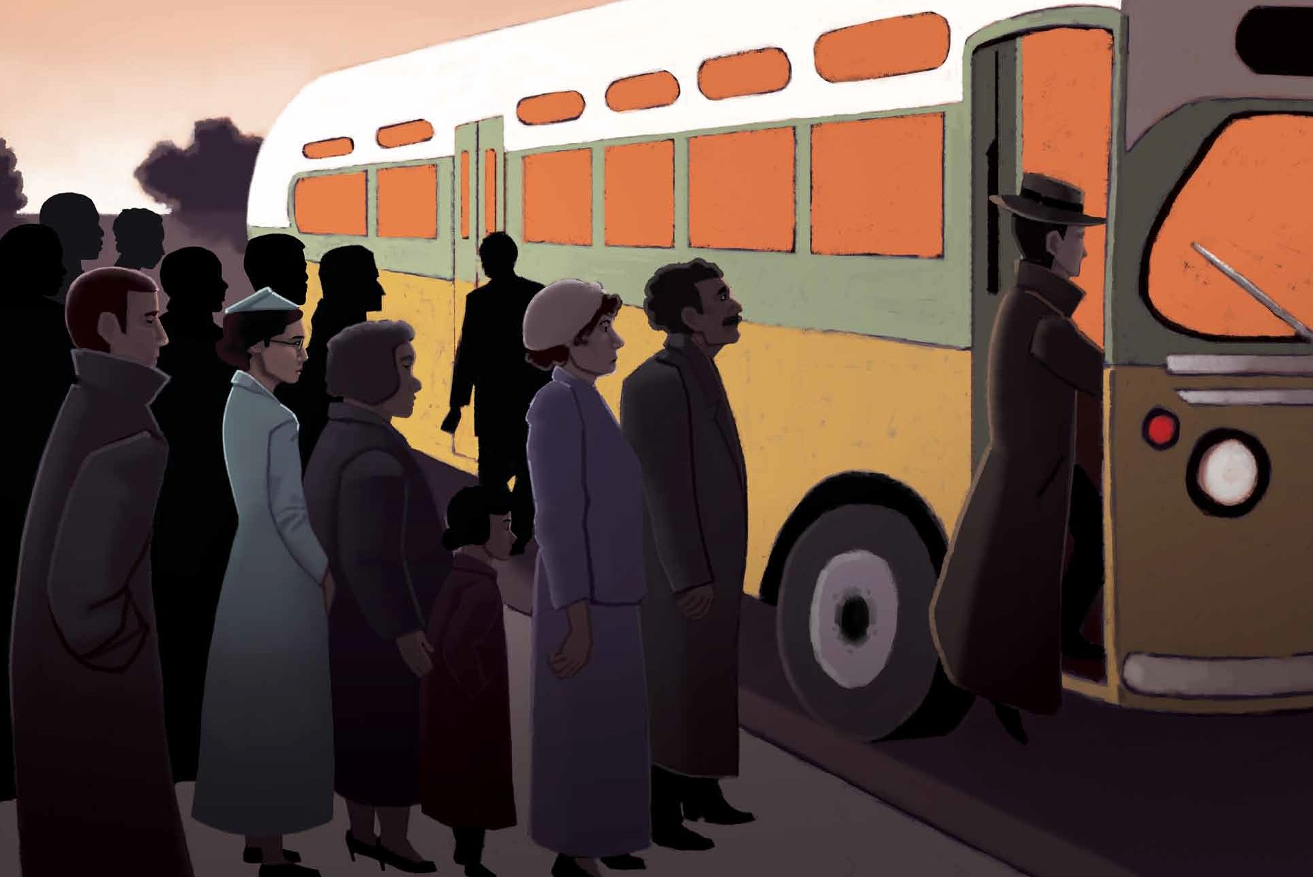

Slide 5


Slide 6


Slide 7
… to be continued in Part 2…

