Slide 1
… continued from Part 1…

Slide 2


Slide 3
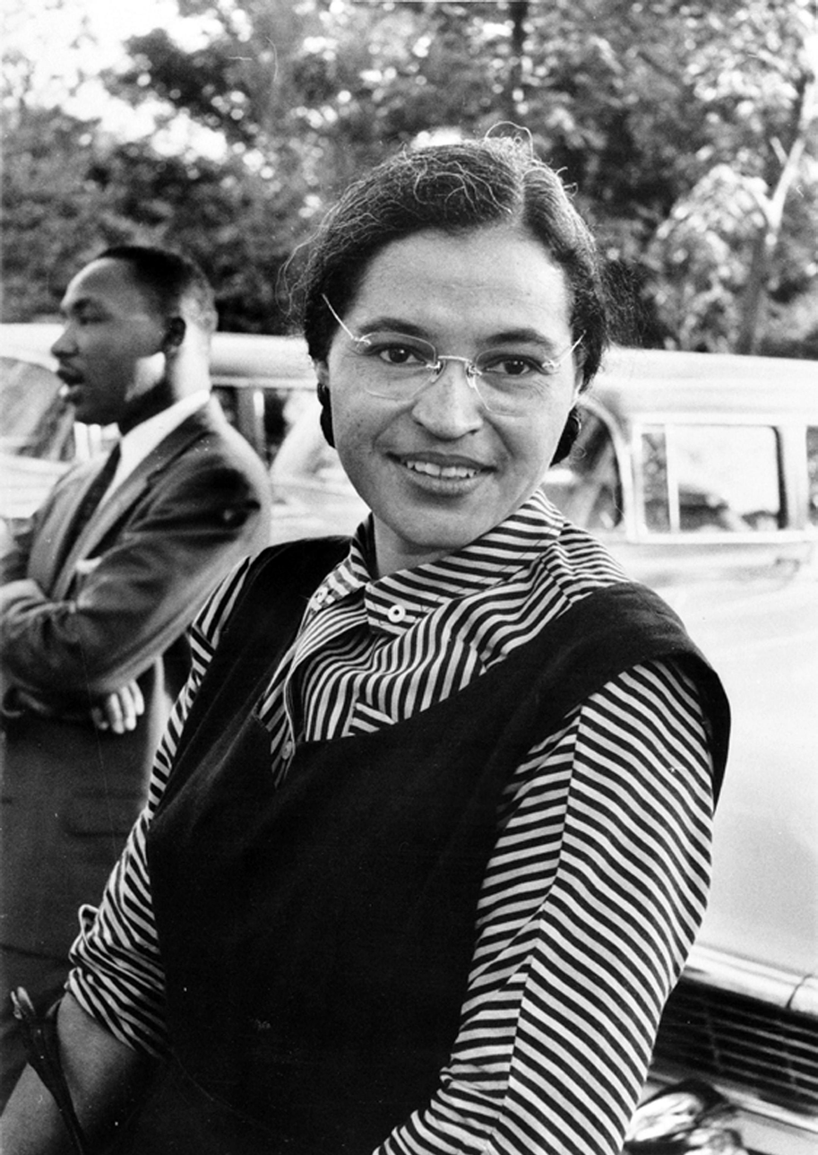

Slide 4
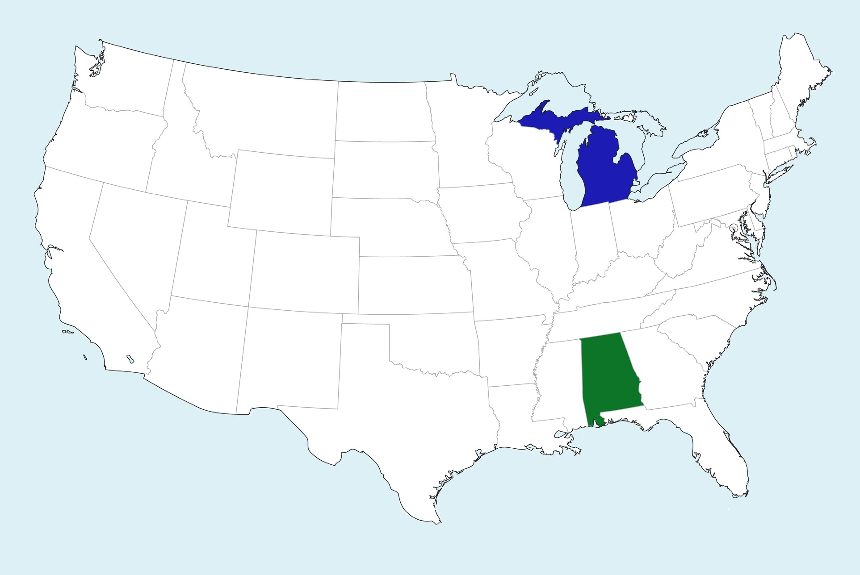

Slide 5

6A-10

