Slide 1
EUROPE
MACEDONIA
Black Sea
Mount Olympus
Hellespont
PERSIAN EMPIRE
Aegean Sea
ASIA
Thermopylae
Thebes
Marathon
Salamis
Athens
Olympia
Mediterranean Sea
Sparta
1A-1
Crete

Slide 2
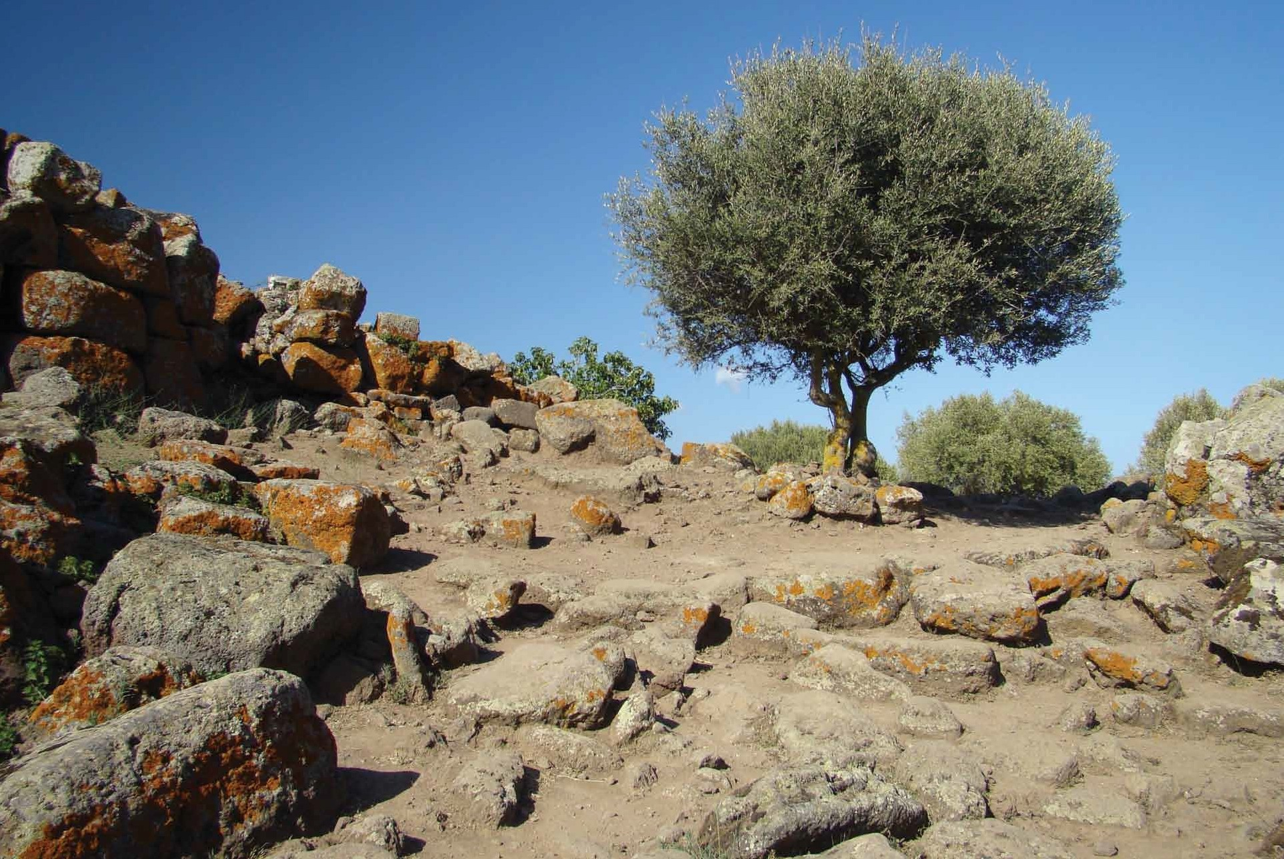

Slide 3
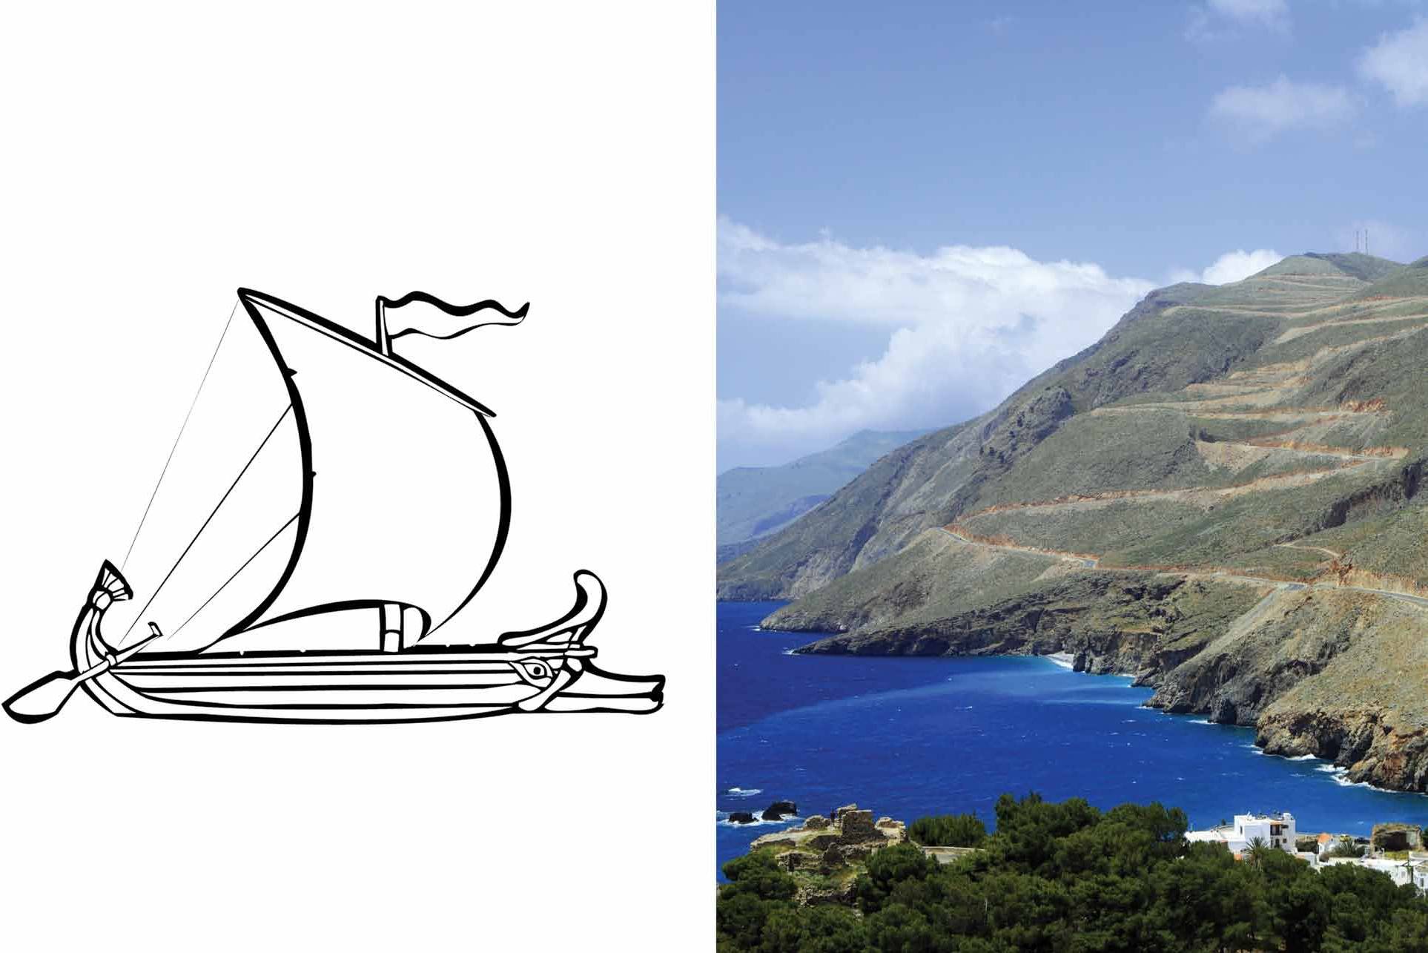

Slide 4
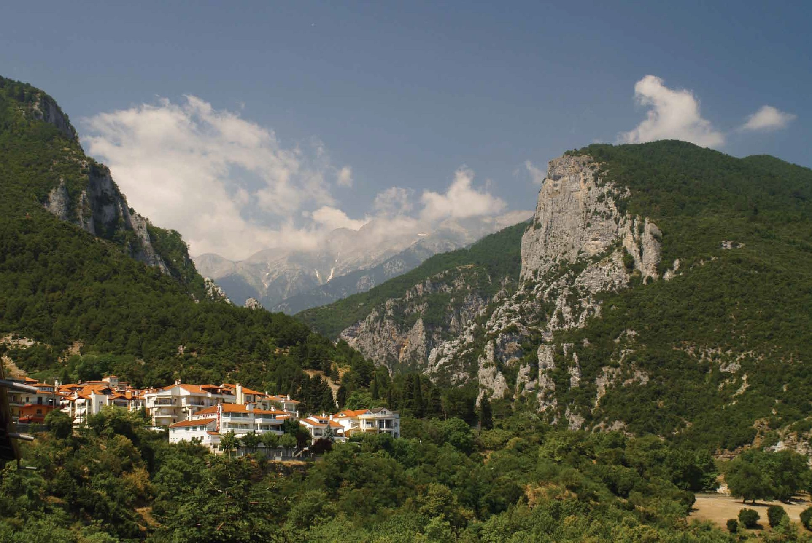

Slide 5
