Slide 1


Slide 2


Slide 3
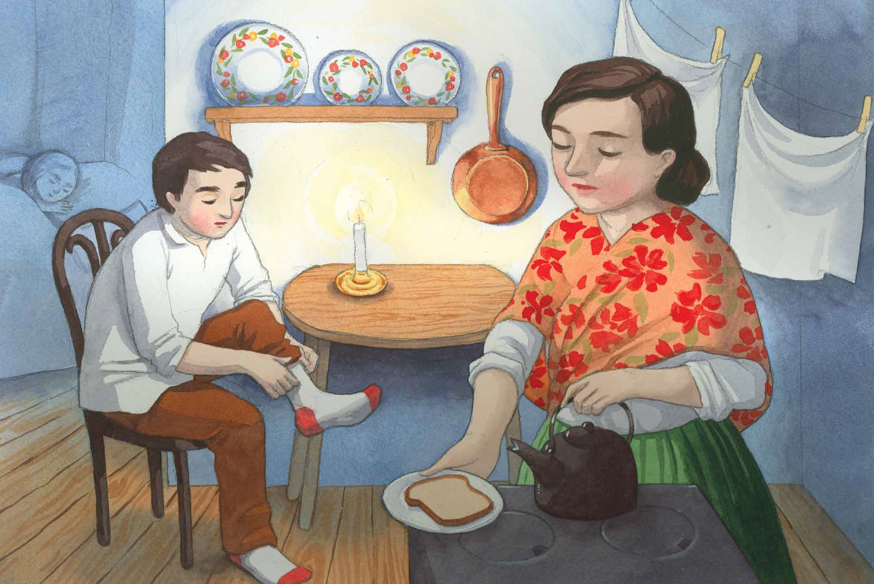

Slide 4


Slide 5


Slide 6
… to be continued in Part 2…

