Slide 1
… continued from Part 1…

Slide 2
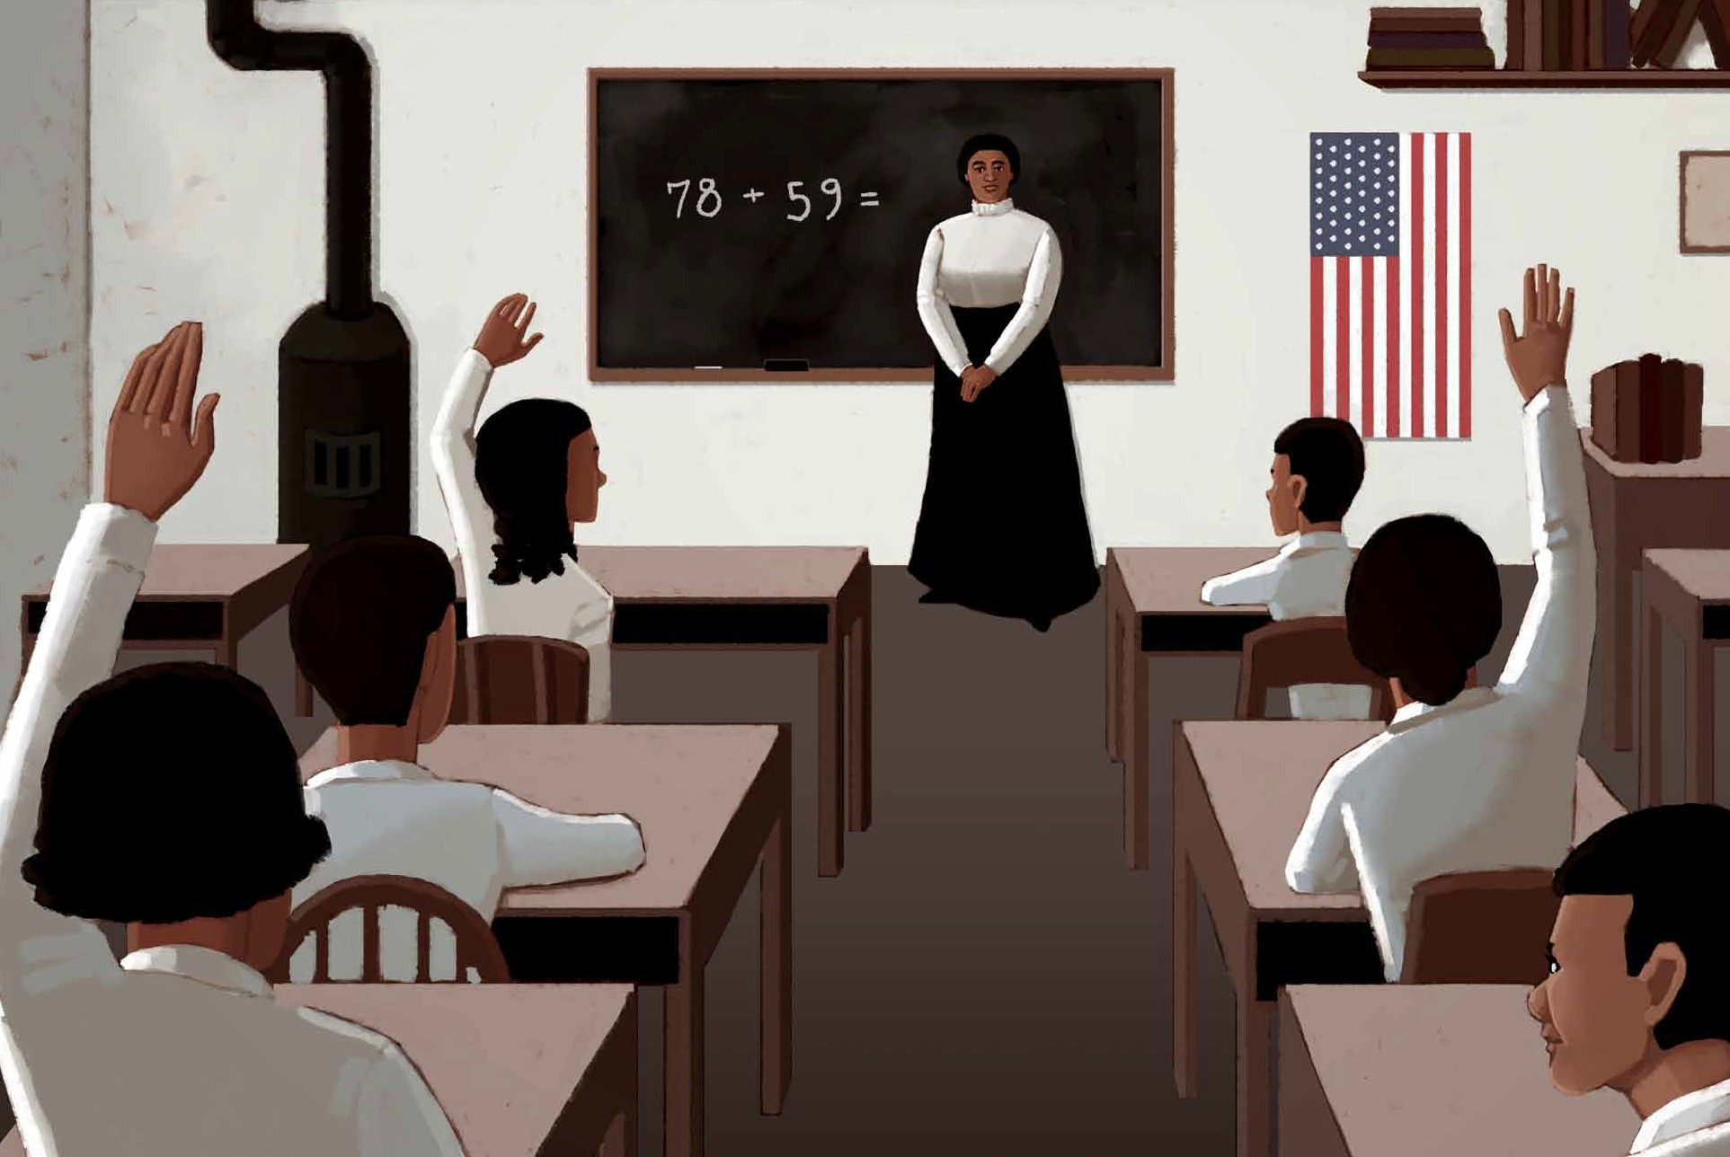

Slide 3


Slide 4


Slide 5


Slide 6
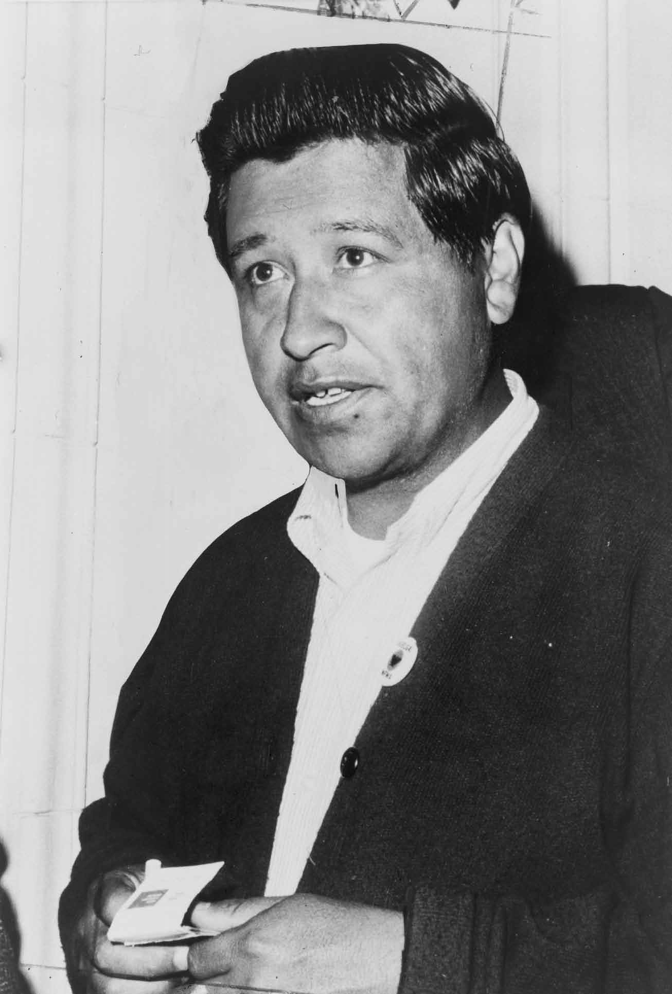
9A-10

Slide 7


Slide 8


Slide 9
